Slide 1
Nutrition and Cystic Fibrosis
Module 2: Nutrition Assessment and Intervention in Pediatric CF

Slide 2
Learning Objectives
Determine appropriate energy, macronutrient, and micronutrient needs for pediatric patients with cystic fibrosis.
Determine appropriate nutrition interventions for pediatric patients with CF.
Discuss the growth and development goals of pediatric CF patients and how these relate to disease progression and prognosis.
Describe appropriate culturally competent approaches to patient care.

Slide 3
Nutrition and CF - Pediatrics
Primary nutrition goal for children with CF is the same as those without CF → BE WELL-NOURISHED!
CF presents challenges above and beyond what is seen with a typical healthy child
  Maldigestion and malabsorption
  Increased oxidative stress
  Increased metabolic rate
  CF related diabetes (CFRD)
  CF-related liver disease
  Possible intestinal resection secondary to meconium ileus

Slide 4
CF and Nutrition in Infancy - (see Table 6.1 of text)
Feeding method needs to be considered
  Breast milk is preferred, but formula is more likely to be provided
  Standard formula vs hydrolyzed protein formula is recommended
  Consider fortified breast milk or high-kcal formula with 22-30 kcal/oz
Micronutrient supplementation – vitamins A, D, E, K, iron, zinc
Supplement salt to feedings/diet
  1/8 tsp/day for ages birth - 6 months
  1/4 tsp/day for ages 6 months – 1 year
www.cff.org

Slide 5
CF and Nutrition in Infancy – PERT
PI diagnosed in as many as 60% of newly diagnosed infants (through newborn screening)
CFF guidelines state that PERT should be initiated in infants with
  Two CFTR mutations associated with PI
  Fecal elastase <200 µg/g
  Also…PERT should be provided even without evidence of fat malabsorption if the above two criteria are met
PERT initiated at a dose of 2000-5000 lipase units each feeding
  Dose can be adjusted up to 2500 lipase units/kg/feeding
  Maximum daily dose of 10,000 lipase units/kg/day to decrease risk of fibrosing colonopathy

Slide 6
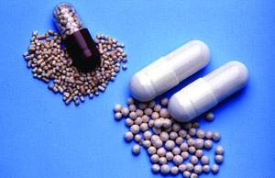
CF and Nutrition in Infancy – PERT
Enzymes active in alkaline environment (small intestine)
Enzyme capsules should be opened and microspheres mixed in acid medium (normally applesauce) to prevent premature activation
Provide orally before feeding
Parent/caregiver should examine infant’s mouth to look for unswallowed enzyme spheres, which could cause mouth sores if not removed
Enzyme activity ~45 min
Enzyme capsules and microspheres

Slide 7
Nutrition Assessment in Pediatric CF

Slide 8
Nutrition and CF
Weight goals
  > 10th percentile for weight-for-age by age 4
  > 50th percentile for BMI or weight-for-length
CFF guidelines mandate that patients be seen at least every 3 months
  Allows for close monitoring of weight and nutrition status
  Patients and parents/caregivers not always adherent to clinic visit schedule

Slide 9
Nutrition Assessment in CF
The same as with any other patient…
Anthropometrics
Biochemical – lab results such as fat-soluble vitamin levels
Clinical – evaluation of skin, mouth, tongue, abdomen, etc.
Diet hx
  Monitor adequacy of kcals, fat, and protein, as well as micronutrients
  If applicable, monitor use of oral supplements or nutrition support

Slide 10
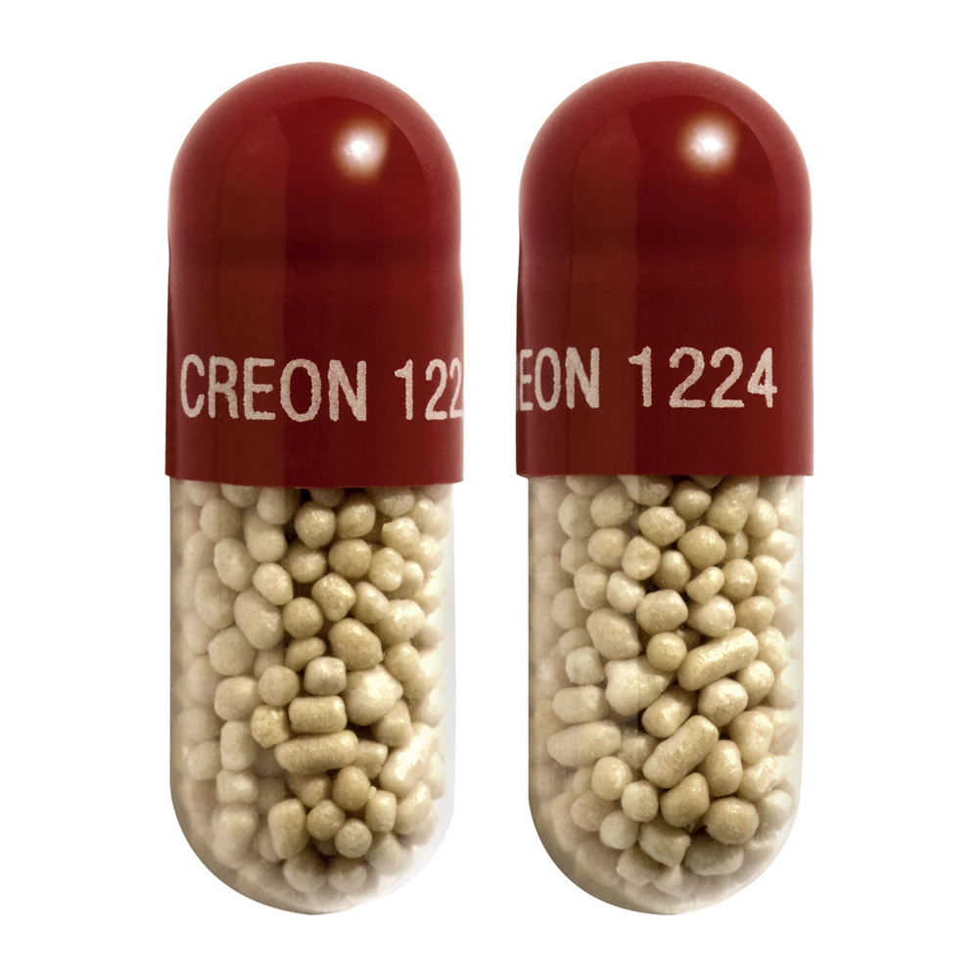
Nutrition Assessment in CF
In addition to ABCD, for CF be sure to add RSVP…
Related Disease/Illness/Genetics/Previous medical history
Stool/GI history
Vitamin history
Pancreatic enzymes
Review Table 7.2 of text for specific details
Pancreatic enzyme capsules (Creon)

Slide 11
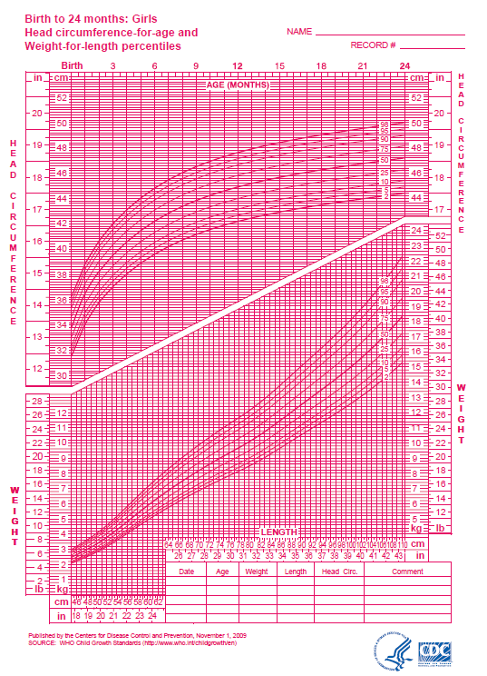
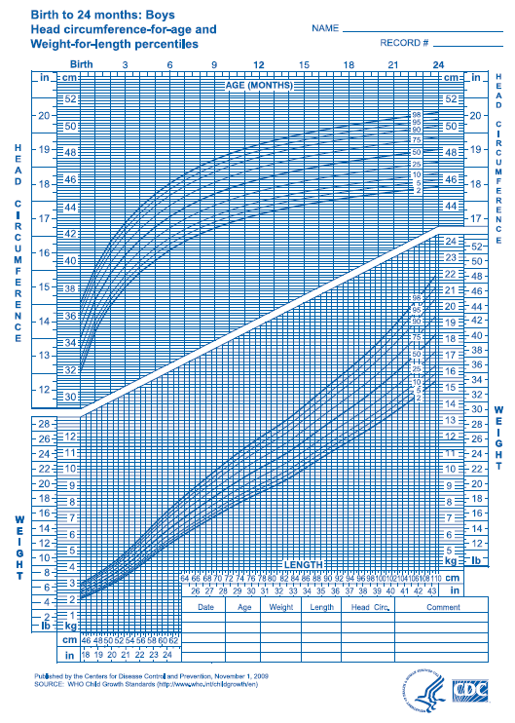
Anthropometrics
Growth charts utilized to monitor growth trends and growth goals

Slide 12
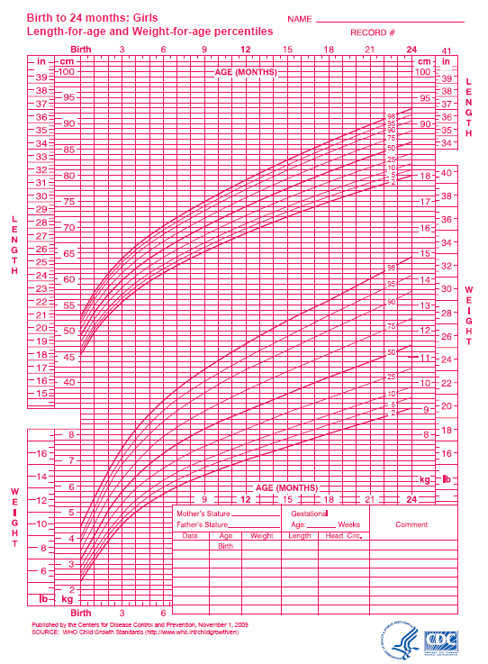
Anthropometrics
Children < 2 years of age growth charts (WHO)
  Weight-for-age
  Length-for-age
  Weight-for-length
Children 2-20 years of age growth charts (CDC)
  Weight-for-age
  Height-for-age
  BMI

Slide 13
Anthropometrics
Expected Rate of Weight Gain (g/d) for Birth-24 months
Appropriate weight gain should be monitored
Each clinic visit a weight goal should be established for subsequent visit
Age Range | Males | Females
Birth-1 month | 30 | 26
1-2 months | 35 | 29
2-3 months | 26 | 23
3-4 months | 20 | 19
4-5 months | 17 | 16
5-6 months | 15 | 14
6-9 months | 10-13 | 10
9-24 months | 7-10 | 7-10
Adapted from Nutrition in Cystic Fibrosis, Yen and Radmer Leonard, Figure 6.1

Slide 14
Anthropometrics
Expected Rate of Weight Gain (g/d) for Ages 2-12
Age Range (yrs) | Male | Female
2-3 | 4.7-6.7 | 5.2-8.2
3-4 | 5.2-8.1 | 5.3-9.0
4-5 | 5.9-9.5 | 5.9-10.0
5-6 | 6.3-10.4 | 6.3-10.9
6-7 | 6.5-11.7 | 6.9-12.2
7-8 | 7.1-13.4 | 7.9-14.2
8-9 | 8.0-15.5 | 9.4-16.6
9-10 | 9.3-17.4 | 10.7-18.8
10-11 | 10.9-18.8 | 11.9-20.0
11-12 | 12.6-19.3 | 12.2-19.7
Adapted from Nutrition in Cystic Fibrosis, Yen and Radmer Leonard, Table 7.5

Slide 15
Biochemical - Recommended Yearly Lab Evaluations
Measurement | Lab to Order | Comments
Comprehensive metabolic profile | CMP | Elevated fasting glucose may indicate CFRD
Complete blood count with differential | CBC with differential | Microcytic anemia – considering checking for iron deficiency
Gamma glutamyl transferase | GGT | Elevated levels may indicate CF-related liver disease
Vitamin A | Retinol | Deficiency – monitor for vision problems
Vitamin D | 25 (OH) Vitamin D | Severe deficiency – consider evaluation for osteoporosis/osteopenia
Vitamin E | Alpha tocopherol | Deficiency – monitor for peripheral neuropathy
Vitamin K | PT/INR | Elevation may be secondary to deficiency or impaired liver synthesis
Adapted from Nutrition in Cystic Fibrosis, Yen and Radmer Leonard , Table 7.6 p 108

Slide 16
Clinical
Clinical Assessment of Possible Nutrient Deficiencies/Issues
 | Finding | Possible Deficiency/Issue
Skin | Pallor | Iron
 | Dermatitis | Zinc
Neck | Enlarged thyroid | Iodine
Mouth | Dry, cracked, red lips | Riboflavin, niacin, vitamin B₆
 | Bleeding gums | Vitamin C
 | Poor taste | Zinc
Eyes | Night blindness | Vitamin A
Hair | Thin, sparse | Zinc
Teeth | Excessive dental carries | Excess simple CHO
 | Enamel hypoplasia | Suggestive of celiac disease
Head to toe assessment including…
  Pulmonary
  GI
Monitor for nutrient deficiencies
Should be completed at each clinic visit
Adapted from Nutrition in Cystic Fibrosis, Yen and Radmer Leonard, Table 7.8

Slide 17
Diet History
Assess adequacy of kcal, protein, fat and micronutrient intake
Assess use of oral supplements and nutrition support, if applicable
Data collection will vary based on patient status
May request food record or conduct 24-hour recall to gain better understanding of dietary intake

Slide 18
Common Nutrition Diagnoses for CF
Inadequate energy intake
Inadequate oral food/beverage intake
Increased nutrient needs
Malnutrition
Inappropriate intake of fats
Inappropriate intake of types of carbohydrates
Inconsistent carbohydrate intake
Altered GI function
Altered nutrition-related laboratory values
Underweight
Involuntary weight loss
Limited adherence to nutrition-related recommendations
Poor nutrition quality of life
Nutrition Therapy and Pathophysiology, Nelms et al.

Slide 19
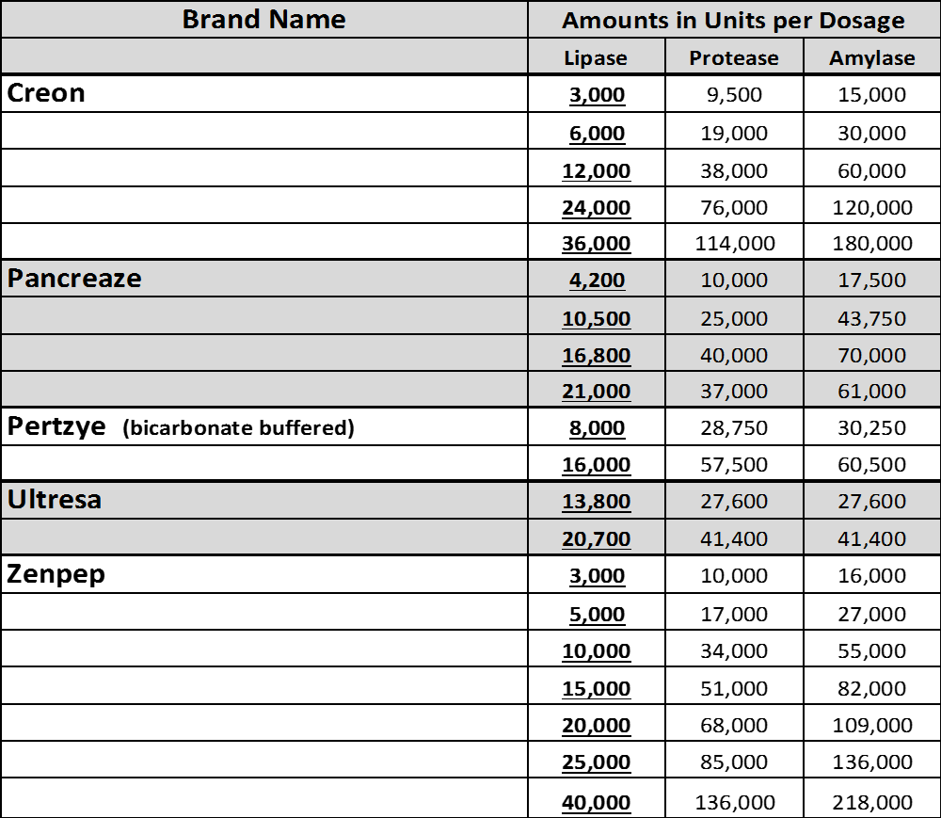
Pancreatic Enzymes

Slide 20
Pancreatic Enzymes
Example of calculations:
  Martin is a 14-year-old with CF who weighs 105 lbs, and takes Creon 24000 → 5/meal, 3/snack. He normally consumes three meals and two snacks each day.
  How many units of lipase is Martin receiving per kg, per meal?
    Convert wt to kg = 105/2.2 = 47.7 kg
    24,000 units lipase/capsule x 5 capsules/meal = 120,000 units lipase/meal
    120,000 units lipase/meal/47.7 kg = 2553 units of lipase/kg/meal
  How many units of lipase is Martin receiving per kg, per day?
    3 meals + 2 snacks = 21 total enzyme capsules/d
    21 x 24000 = 504,000 units lipase/d / 50.9 kg = 9901 units lipase/kg/d
  Does Martin’s enzyme regimen fit with CFF guidelines?
    Yes, the maximum recommended units lipase/kg/meal = 2500 and units lipase/kg/d = 10,000
    Martin is at the upper level of the recommendation for units lipase/kg/meal
    Could consider switching to Creon 36000 to decrease pill burden by about 7 pills/day

Slide 21
Nutrition Intervention in Pediatric CF

Slide 22
Nutrition Intervention
Goals include appropriate growth and development
  High kcal, high fat, high protein diet
  Monitor micronutrients especially fat-soluble vitamins
  Adherence to PERT, vitamin/mineral supplements, oral supplements, TF (if applicable)
  Set weight goal for each CF clinic visit
Nutrition education and counseling
  Patient- and family-centered approach
  Set goals with patients and family based on individual patient needs
Utilize benchmarking and quality improvement techniques – see text Table 9.2

Slide 23
CFF Recommendations for
Weight-for-stature Assessment
Age Group | Recommended weight-for-stature goal
<2 years | > 50th percentile wt-for-length
2-20 years | > 50th percentile BMI
>20 years (female) | BMI > 22
>20 years (male) | BMI > 23
Adapted from Nutrition in Cystic Fibrosis, Yen and Radmer Leonard, Table 9.5

Slide 24
Nutrition Intervention
Strategies for increasing kcal and fat intake
  “Boosting” meals and snacks – increase energy content without increasing volume of food
    “Super” milk – 4 oz whole milk + 2 Tbs cream
    Use only whole milk or cream if tolerant of dairy products
    Add butter, margarine, cream, peanut butter to foods
  Oral supplements as tolerated
  Smaller, frequent meals if feasible
Poor growth or lagging weight gain with diet interventions may indicate need for additional intervention strategies
PPI or H2 blocker may be added to medication regimen to increase effectiveness of PERT

Slide 25
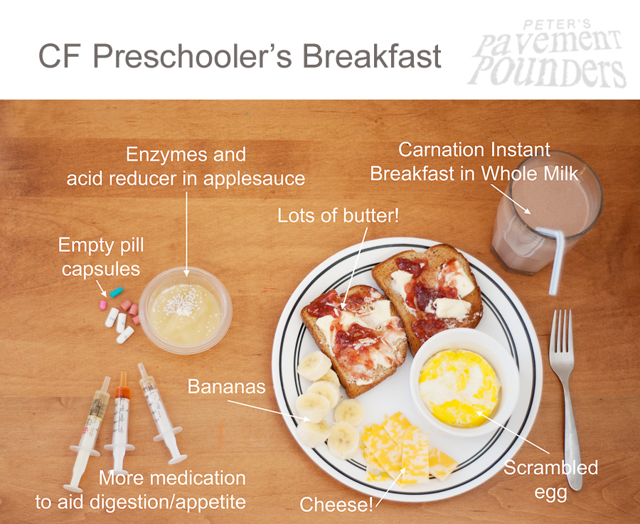
http://www.peterspavementpounders.org/

Slide 26
Nutrition Intervention – Supplemental TF (STF)
Indicated based on many considerations
  Previous nutrition interventions
  Comorbid conditions
  Psychosocial factors, financial and time resources that may affect adherence
One study indicated that children treated with STF were 10x more likely to meet BMI goal than controls (Bradley et al.)
Use in conjunction with nutrition counseling
PEG or gastrostomy feeds preferred
Nocturnal, (continuous) feeds allow for adequate oral intake during the day

Slide 27
Nutrition Intervention - STF
Formula
  Intact polymeric formula seems to be better tolerated in CF population
  Caloric density ranges 1.0-2.0 kcal/mL based on individual need
Calorie goals for STF
  20-60% of estimated needs based on individual need and tolerance, as well as formula type used
  Higher caloric density formulas provide less volume, and thus may be better tolerated and promote normal eating patterns during the day
STF and PERT – research is lacking but CF Consensus Committee suggests…
    Provide enzymes orally just before starting TF
    Mealtime dose
    Possible additional doses needed mid-way or at the end of the feeding
Monitor glucose tolerance once TF initiated

Slide 28
Nutrition Intervention – Appetite Stimulant
Use is common to treat anorexia and to promote weight gain
Medication options
  Megesterol acetate (Megace)
  Cyproheptadine hydrochloride (Periactin)
  Dronabinol (Marinol) – limited research on use in CF patients
  Mirtzapine (Remeron) – limited research on use in CF patients
Effective as a short term treatment
Monitor for side affects – impaired glucose tolerance, osteoporosis
Monitor adherence – treatment adds to pill burden

Slide 29
References
Nutrition in Cystic Fibrosis, Yen and Radmer Leonard - Chapters 4-7, 9-10
Cystic Fibrosis Foundation – www.cff.org
Nutrition Therapy and Pathophysiology, Nelms et al., 2nd Ed, Chapter 21
Centers for Disease Control and Prevention (CDC), growth charts - http://www.cdc.gov/growthcharts/who_charts.htm
Bradley et al. Nutrition outcomes following gastrostomy in children with cystic fibrosis. Pediatr Pulmonol. 2012;47(8):743-8.
Peter’s Pavement Pounders - http://www.peterspavementpounders.org/

